Slide 1
Craft of Data Visualization
Visualization of Machine Learning models
Alexey Zaytsev,
Skoltech, CDISE
16 January

Slide 2
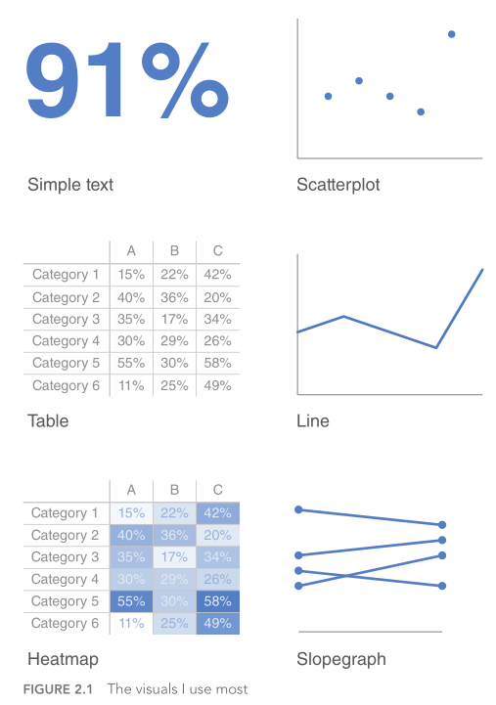
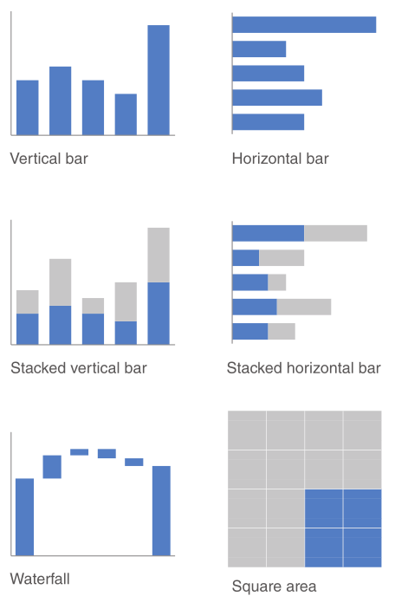
There is a lot of basic plots
Knaflic, C.N. Storytelling with data: A data visualization guide for business professionals. John Wiley & Sons, 2015

Slide 3
We need specific plot for particular application areas They are just basic plots, but with specific curves or points displayed We consider machine learning as an example
Notes:
Specific language in each area: how we say about something and how we tell stories

Slide 4
Main problem statements in Machine Learning
Regression
Classification
Unsupervised machine learning models

Slide 5
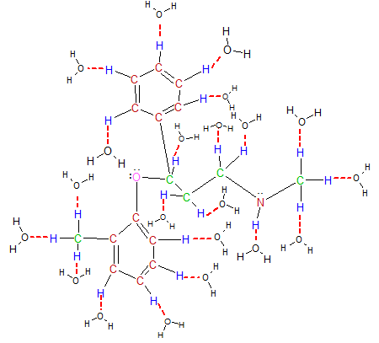
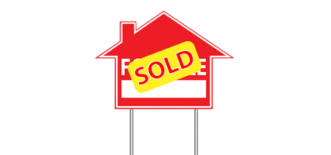
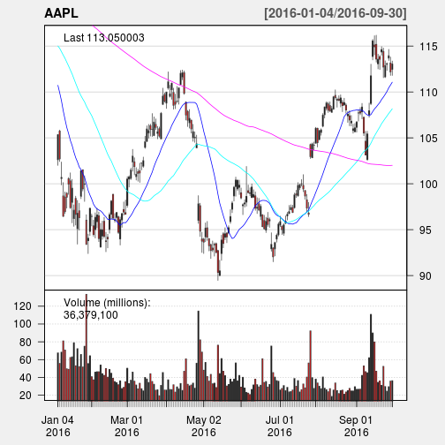
For regression target is continuous
We want to predict the target continuous value
Examples:
Predict solubility of a molecule
Predict price of a house
Predict performance of a portfolio

Slide 6
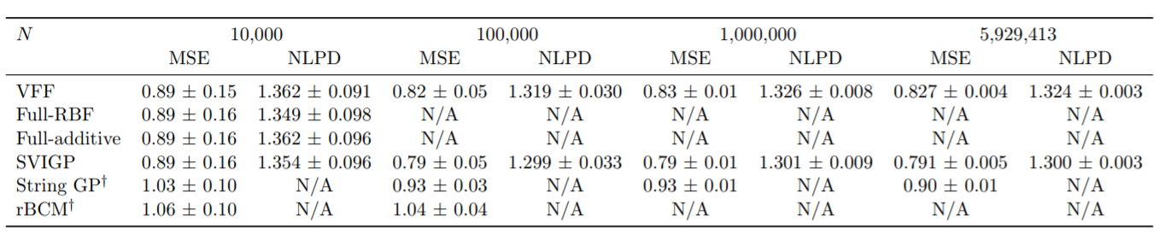
Simplest way: measure errors for different approach and get table
Hensman, James, Nicolas Durrande, and Arno Solin. "Variational Fourier features for Gaussian processes." Journal of Machine Learning Research 18, no. 151 (2018): 1-52.

Slide 7
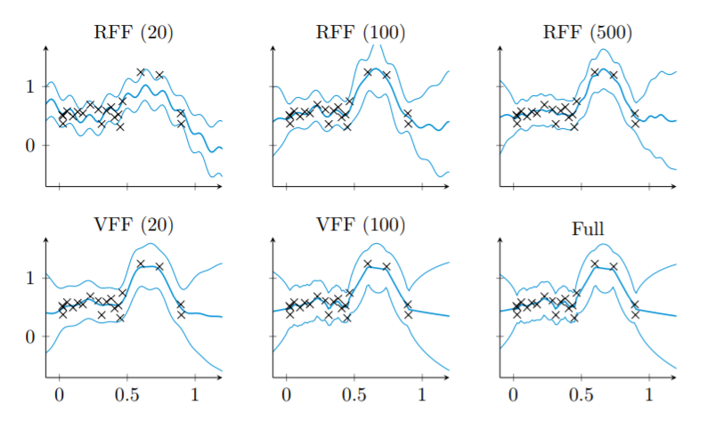
Another simple way is to plot the model itself
Hensman, James, Nicolas Durrande, and Arno Solin. "Variational Fourier features for Gaussian processes." Journal of Machine Learning Research 18, no. 151 (2018): 1-52.

Slide 8
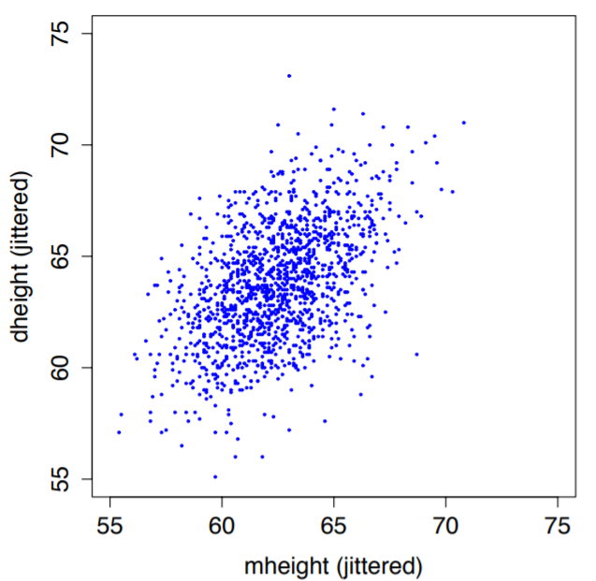
Scatter plot
http://staff.washington.edu/dbp/s423/PDFs/01-chapter-ALR-for-printing.pdf

Slide 9
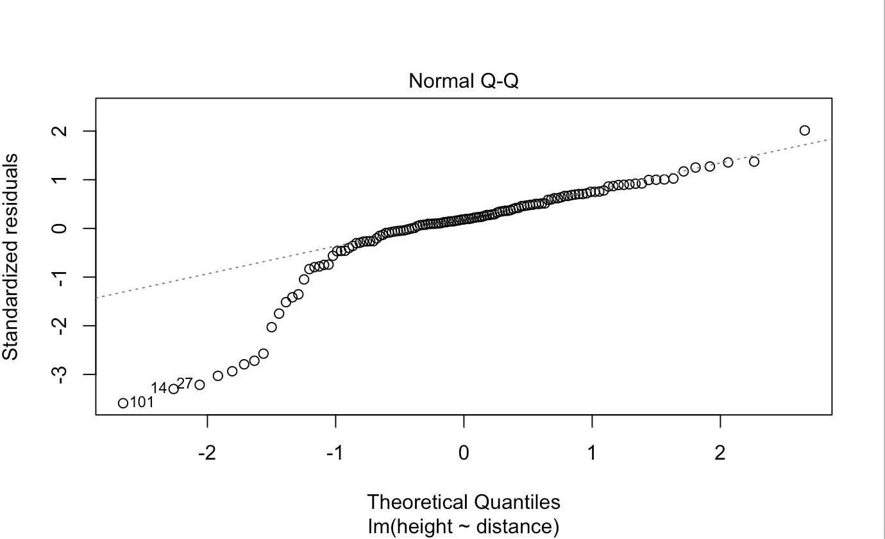
QQ plot
https://stats.stackexchange.com/questions/253916/what-does-this-q-q-plot-indicate-about-my-data

Slide 10
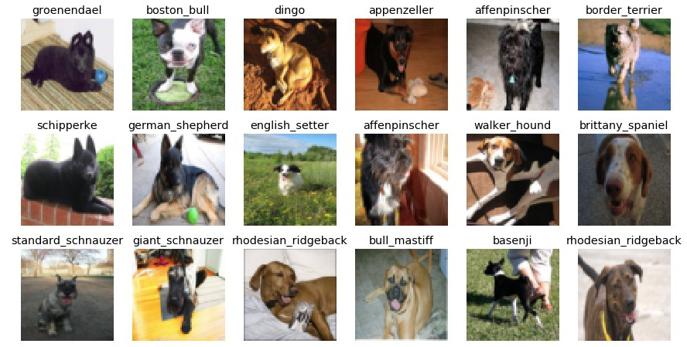
For classification target is discrete
We want to predict the target class of an object
Examples:
Is the molecule a good drug?
Will the customer pay a mortgage?
What dog breed is at the figure?

Slide 11
Simplest way: measure errors
Accuracy
TPR
FPR
Confusion matrix

Slide 12
Simplest way: ROC & PR curves
ROC curve
PR curve

Slide 13
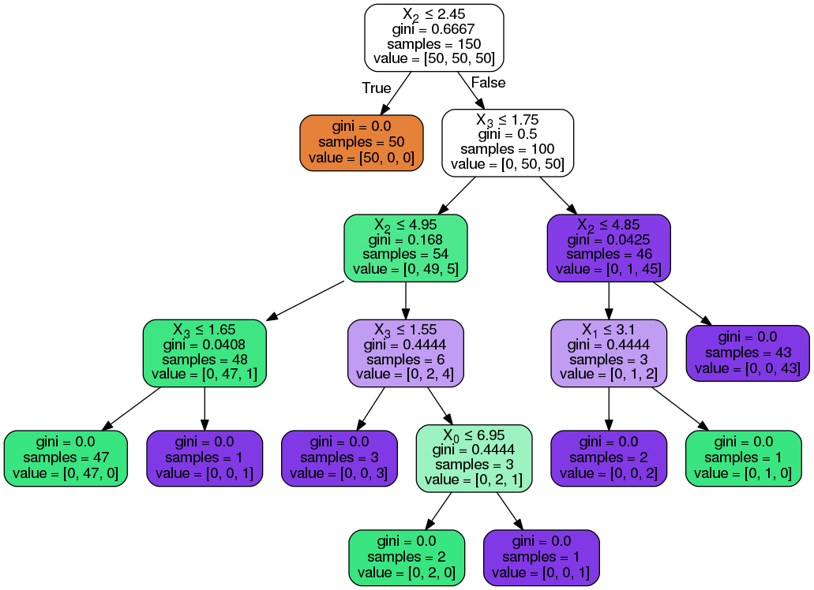
Visualize the model: decision tree
https://medium.com/@rnbrown/creating-and-visualizing-decision-trees-with-python-f8e8fa394176

Slide 14
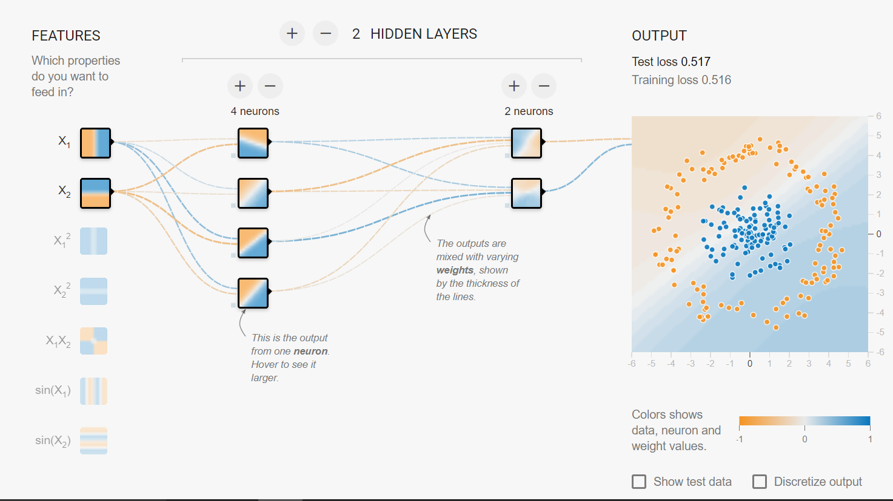
Visualize the model: Neural Network
https://playground.tensorflow.org/

Slide 15
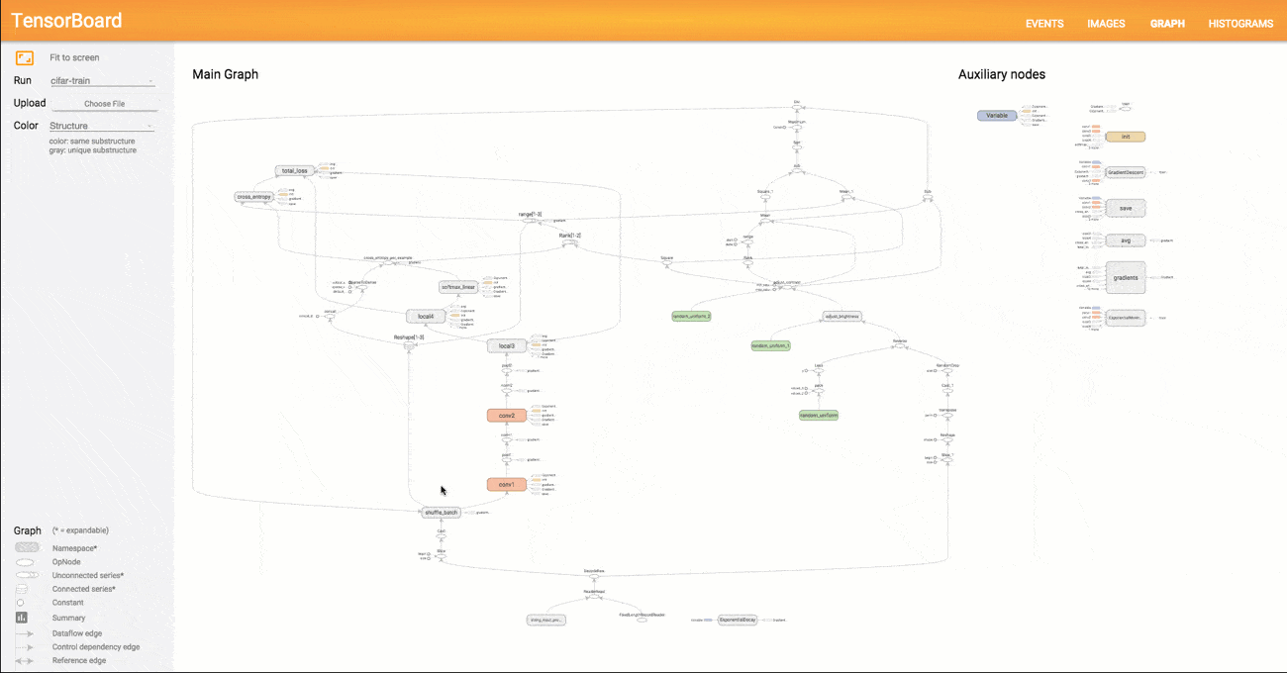
Visualize the model: Neural Network with Tensorboard
https://www.tensorflow.org/guide/graph_viz

Slide 16
1. Understand the context
Who
Your audience
You
What
Action
What do you need your audience to know or do?
Mechanism
How will you communicate to your audience?

Slide 17
1. Understand the context
Who
Your audience
You
What
Action
What do you need your audience to know or do?
Mechanism
How will you communicate to your audience?
How
What data is available that will help make my point?

Slide 18
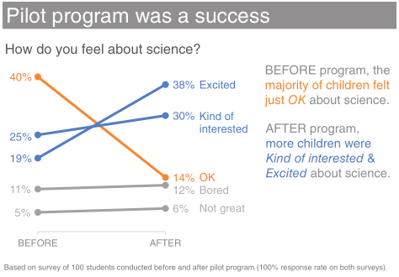
1. Understand the context: example
Who: The budget committee that can approve funding for continuation of the summer learning program.
What: The summer learning program on science was a success; please approve budget of $X to continue.
How: Illustrate success with data collected through the survey conducted before and after the pilot program.

Slide 19
2. Choose an appropriate visual display
Knaflic, C.N. Storytelling with data: A data visualization guide for business professionals. John Wiley & Sons, 2015. p. 37

Slide 20
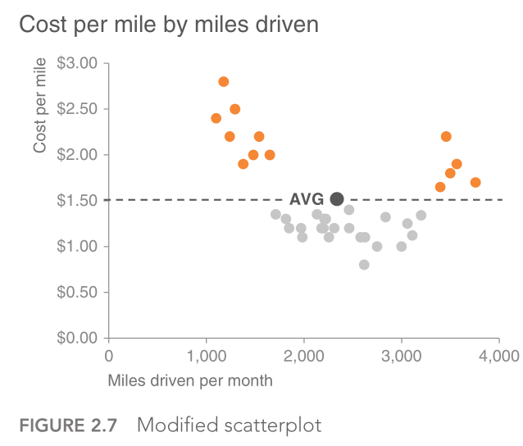
Main display types
Simple text
Tables
Graphs

Slide 21
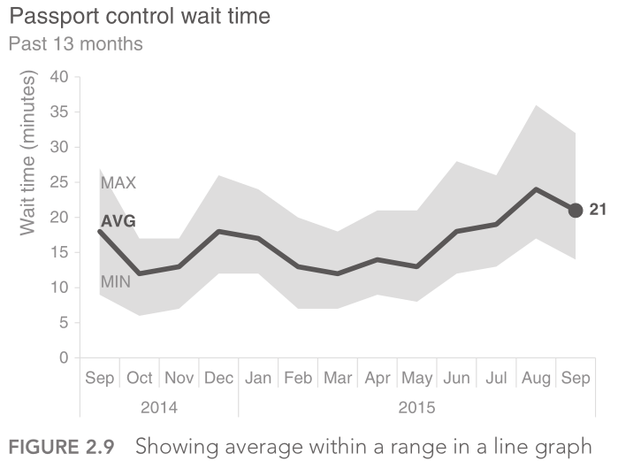
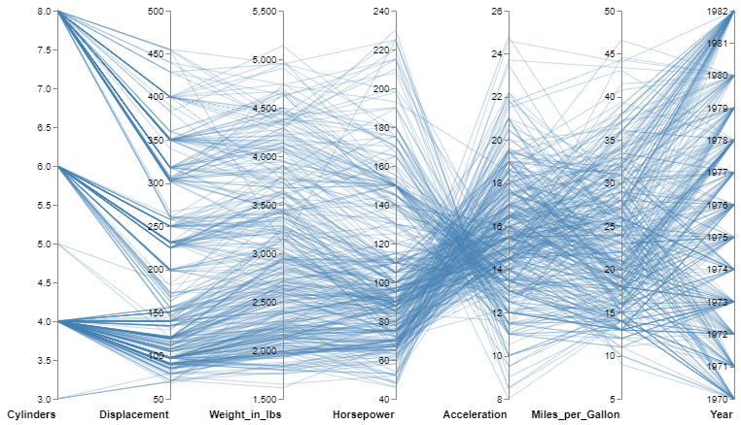
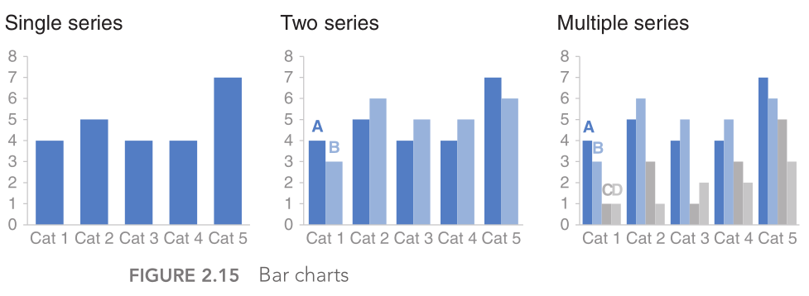
Graph types
Scatter plot
Lines
Parallel coordinates
Bars

Slide 22
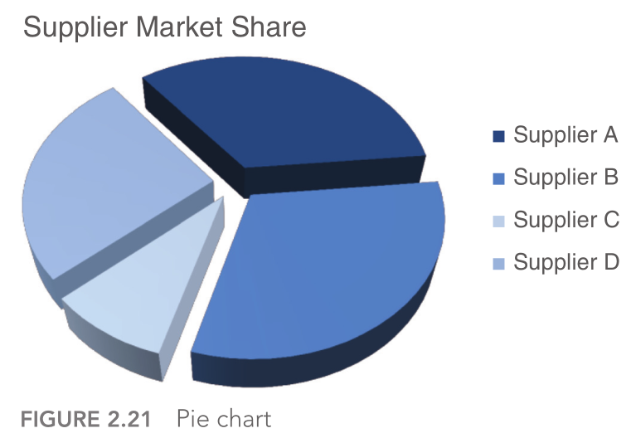
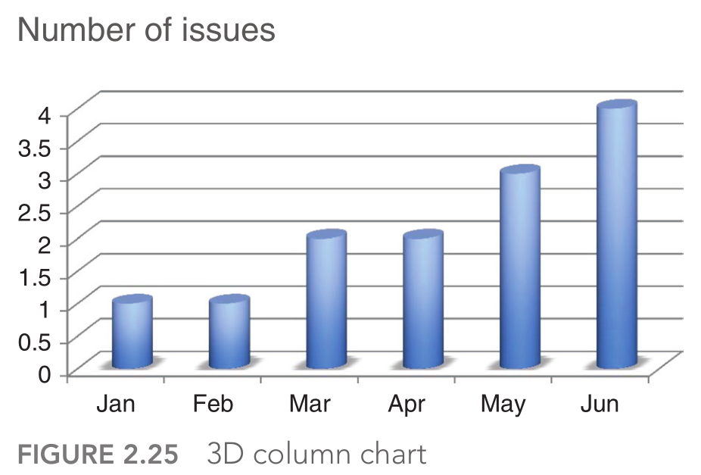
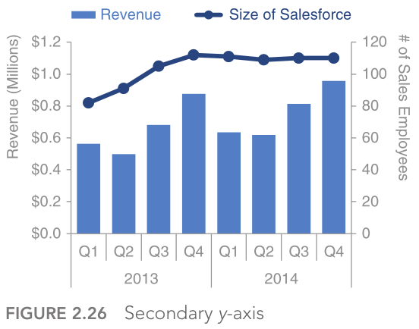
Graph types to avoid
Pie charts are evil
Never use 3D
Secondary y‐axis: generally not a good idea

Slide 23
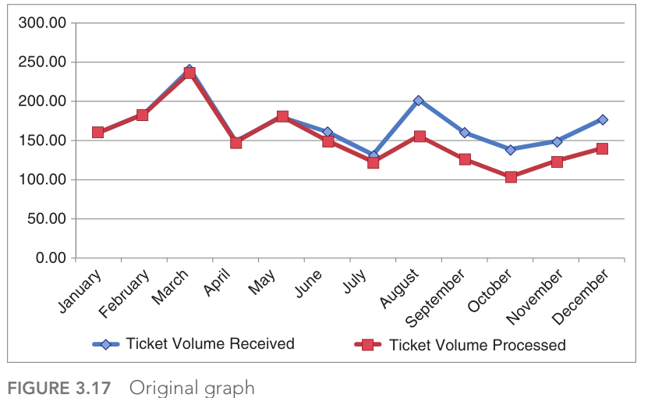
3. Eliminate clutter

Slide 24
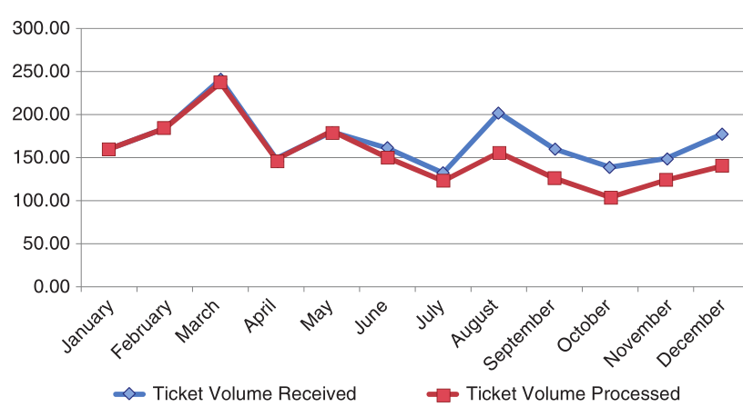
Remove chart border

Slide 25
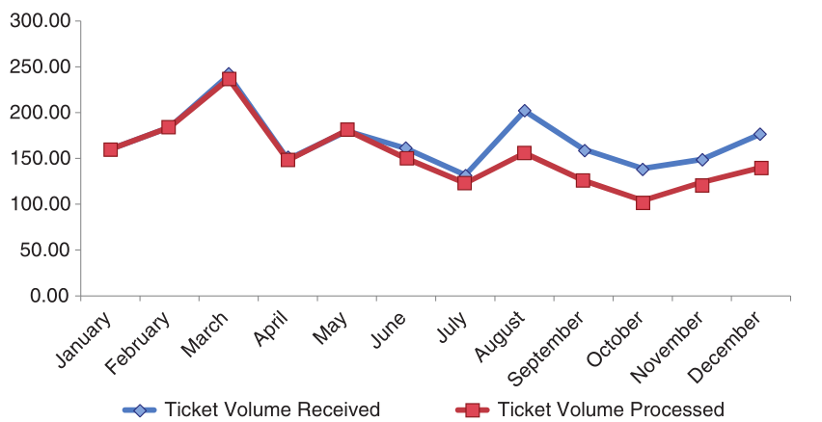
Remove gridlines

Slide 26
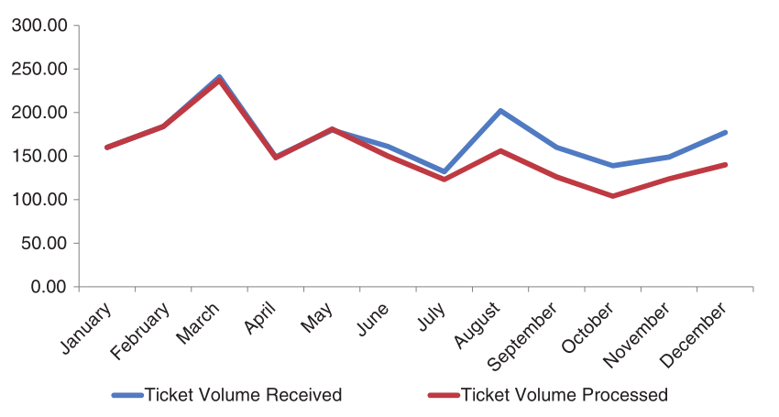
Remove data markers

Slide 27
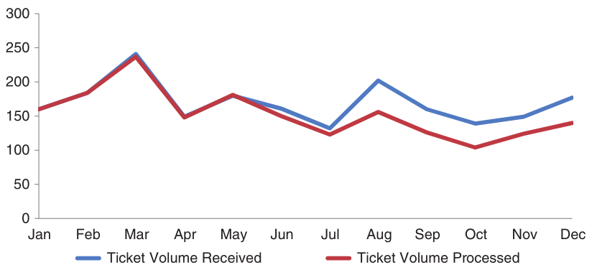
Clean up axis labels

Slide 28
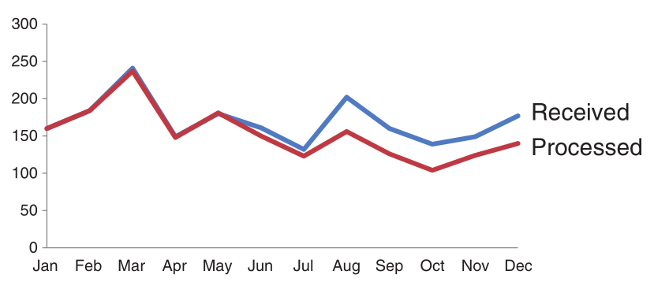
Label data directly

Slide 29
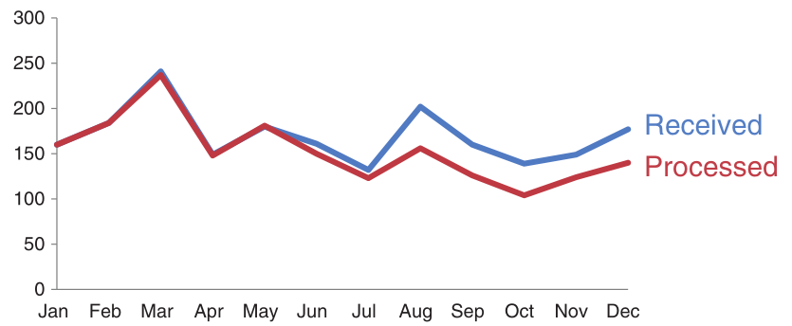
Leverage consistent color

Slide 30
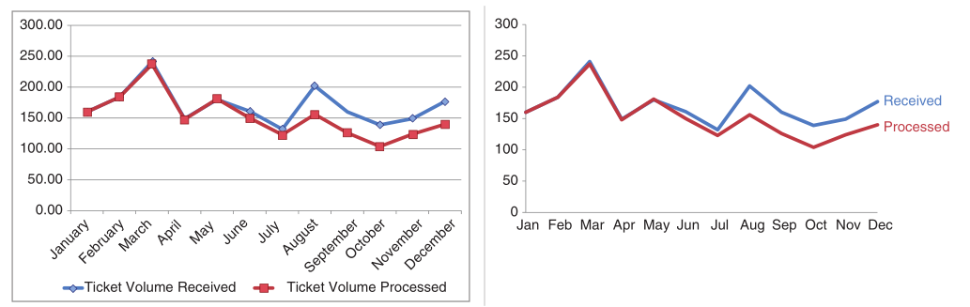
Before and after

Slide 31
4. Focus attention where you want it

Slide 32
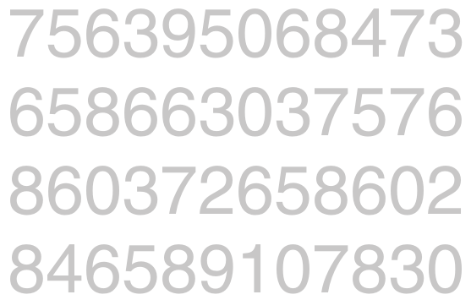
Count the 3s

Slide 33
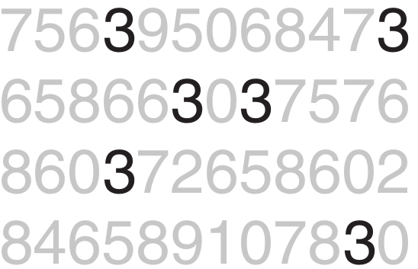
Count the 3s with preattentive attributes

Slide 34
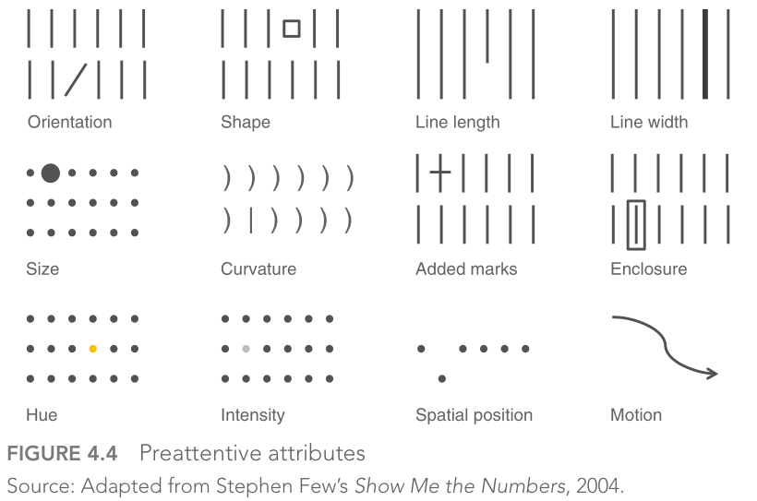
Types of preattentive attributes

Slide 35

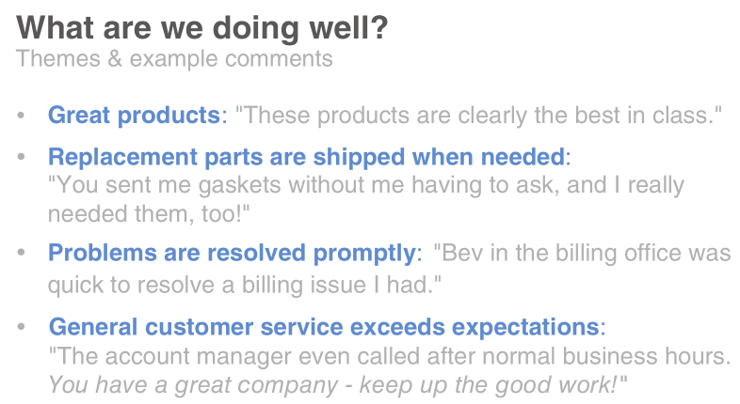
Example of preattentive attributes in text

Slide 36
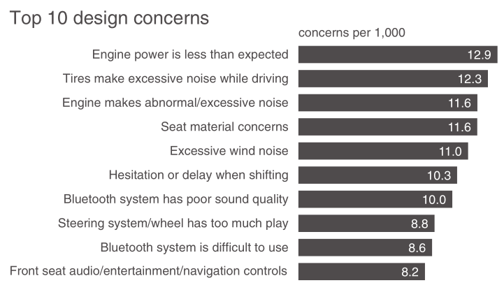
Example of preattentive attributes in graphs

Slide 37
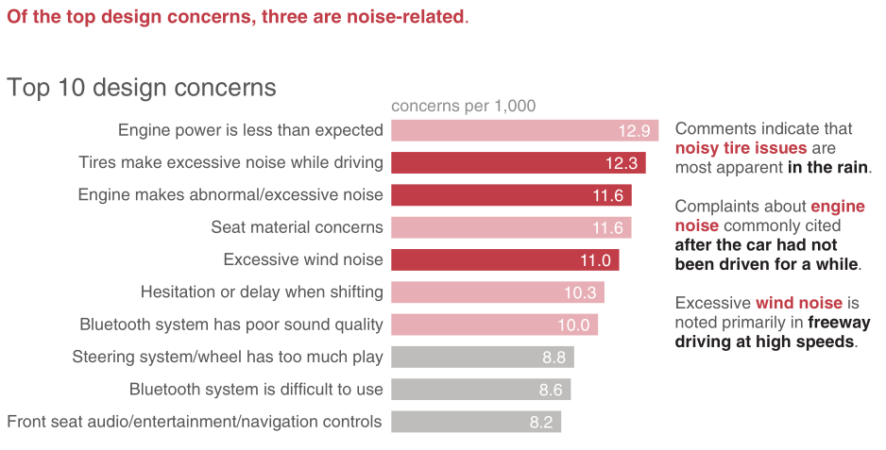
Example of preattentive attributes in graphs

Slide 38
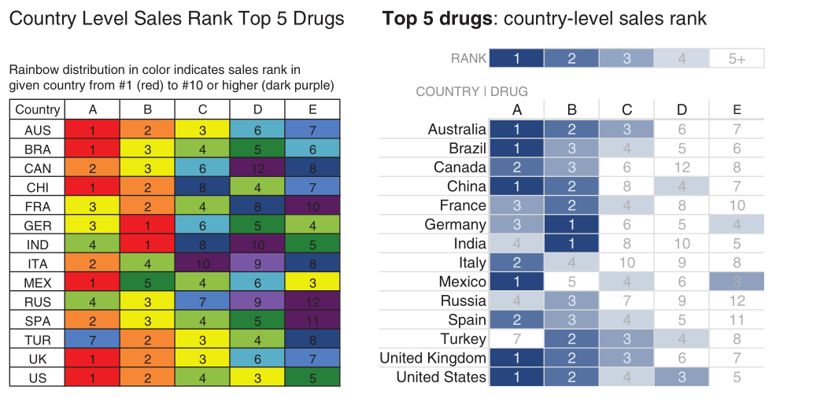
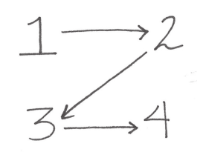
Other preattentive attributes
Size
Color
Position on page

Slide 39
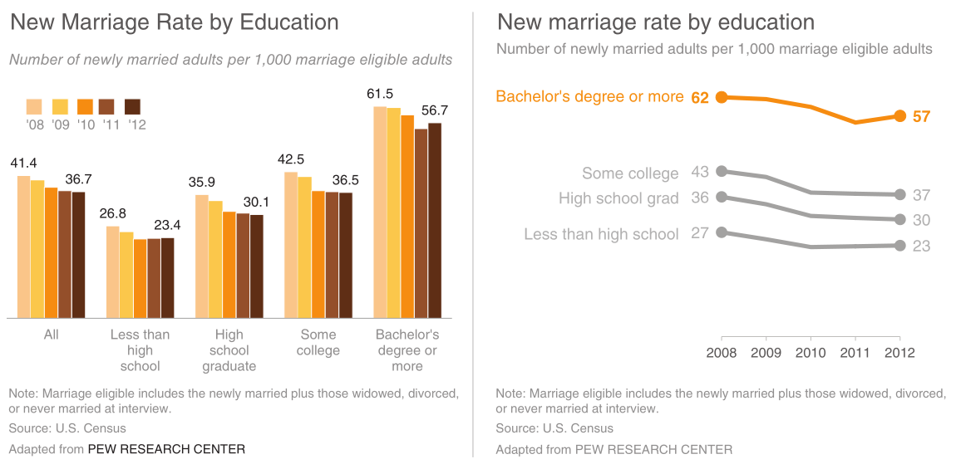
5. Think like a designer
Before After

Slide 40
5. Think like a designer
Before After

Slide 41
5. Think like a designer
Form follows function. This adage of product design has clear application to communicating with data.

Slide 42
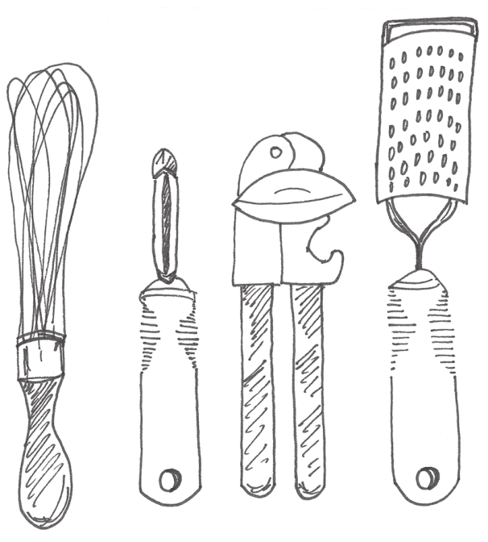
Three A-principles of design
Affordances
Accessibility
Aesthetic

Slide 43
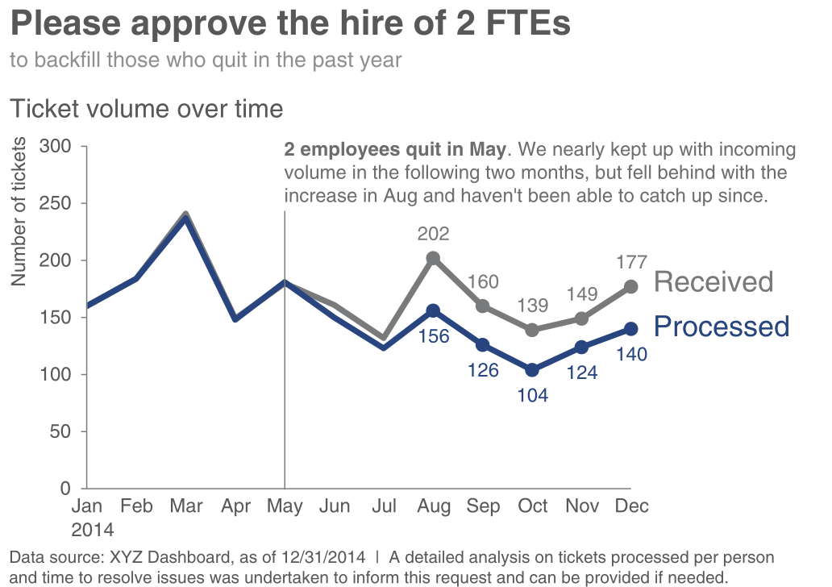
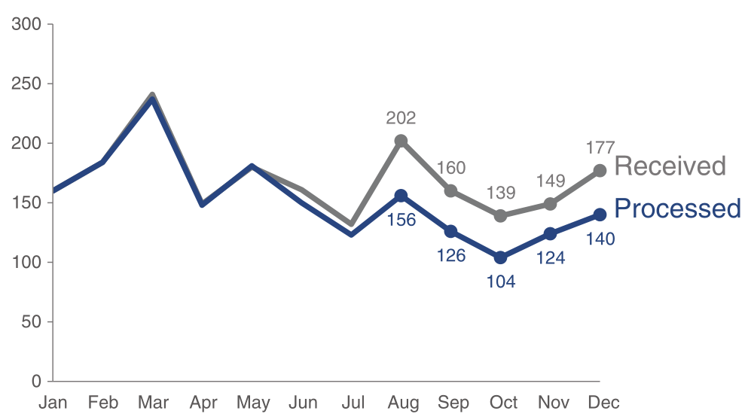
5. Think like a designer
Before After

Slide 44
5. Think like a designer
Before After

Slide 45
5. Tell a story
1. The setting: When and where does the story take place?
2. The main character: Who is driving the action? (This should be framed in terms of your audience!)
3. The imbalance: Why is it necessary, what has changed?
4. The balance: What do you want to see happen?
5. The solution: How will you bring about the changes?
Beyond Bullet Points, Cliff Atkinson

Slide 46
Three arcs structure
The beginning: problem introduced
The middle: how to solve the problem
The end: call to action
tie it back to the beginning

Slide 47
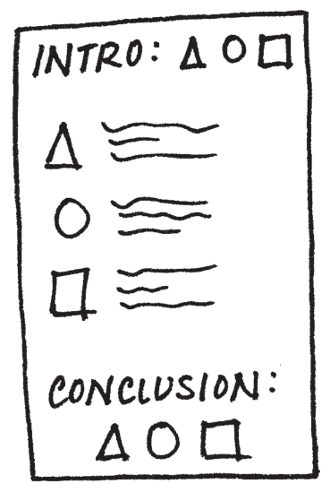
A quick intro on storytelling with data
Understand the context
Choose an appropriate visual display
Eliminate clutter
Focus attention where you want it
Think like a designer
Tell a story

